Slide 1
SWE 4803
Lec - 4

Slide 2
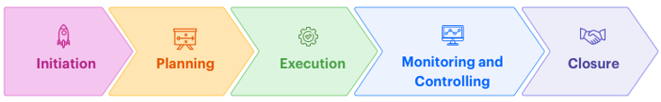
Project life cycle
Pre-Project work
Starting the Project
Initiating Process Group
  Develop Project Charter
  Identify Stakeholders
Need for Assessment
Business Case
Project Charter
Business Case
Business Mgt Plan

Slide 3
Develop Project Charter
Process
Output
Develop Project Charter
Project Charter
Assumption Log

Slide 4
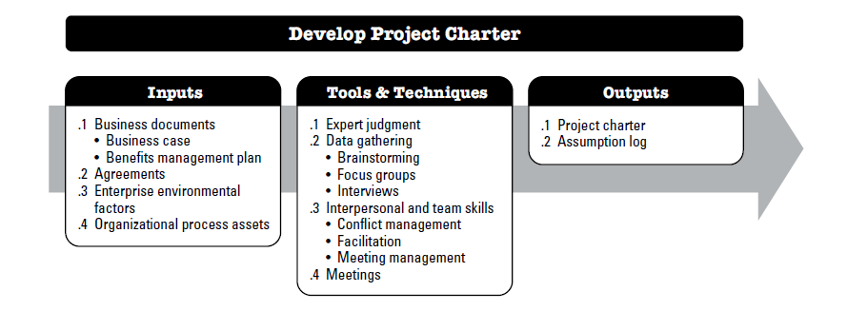
Project Charter

Slide 5
Develop Project Charter
Why????
formally authorizes the existence of a project and provides the project manager
Provide with the authority to apply organizational resources to project activities.
Creates a formal record of the project, and shows the organizational commitment to the project

Slide 6
Develop Project Charter
Basic Fact:
Who creates the charter
  Sponsor
  Project manager can assist him in the process
When
  As early as possible
  Best when the project is assigned
  If not possible, PM must be assigned before planning
Contents
  Should have name of the project manager
  Should be within 2/3 pages.
  It should be broadly framed with very high-level milestones, tentative cost etc. to initiate data
Approved by
  Someone external to the project like sponsor, PMO, portfolio steering committee
  Who can fund the project

Slide 7
Develop Project Charter
Input:
Business documents
Agreements
Enterprise Environmental factors (EEF)
Organizational Process Assets (OPA)

Slide 8
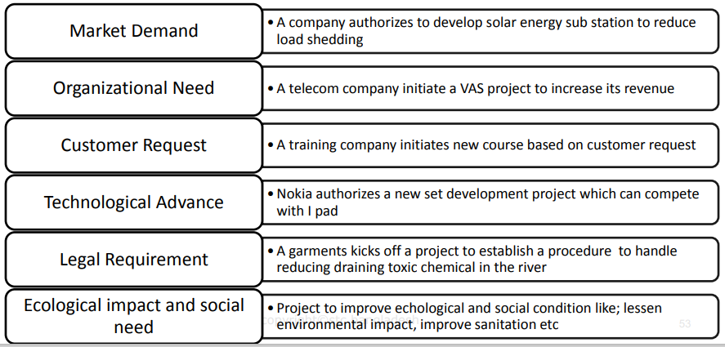
Develop Project Charter
Input: Business documents
Generally, it contains business need and cost benefit analysis to justify the project

Slide 9
Develop Project Charter
Input: Agreement
Agreements are used to define initial intentions for a project
  Contract
  Memorandum of understanding (MOU)
  Service Level Agreement (SLA)
  Letter of agreement

Slide 10
Develop Project Charter
Input: Enterprise Environmental Factor
EEF
Organizational culture and political climate,
Legal and regulatory requirements
Stakeholders’ expectations
Marketplace conditions,
industry standards

Slide 11
Develop Project Charter
Input: Organizational process assets
OPA
Organizational standard policies, processes, and procedures
Portfolio, program, and project governance framework
Monitoring and reporting methods
Templates
Historical information and lessons learned repository

Slide 12
Develop Project Charter
Tools & Techniques:
Expert Judgement
Data gathering
Interpersonal and team skills
Meetings

Slide 13
Develop Project Charter
Tools & Techniques: Expert Judgement
Expert judgment is defined as judgment provided based upon expertise in an application area, Knowledge Area, discipline, industry, etc
For this process, expertise should be considered from individuals or groups with specialized knowledge or training in the following topics:
  Organizational strategy,
  Benefits management,
  Technical knowledge of the industry and focus area of the project,
  Duration and budget estimation, and
  Risk identification.

Slide 14
Develop Project Charter
Tools & Techniques: Data Gathering
Brainstorming
used to identify a list of ideas in a short period of time
Brainstorming comprises two parts: idea generation and analysis.
Focus groups
Focus groups bring together stakeholders and subject matter experts to learn about the perceived project risk, success criteria, and other topics
Interviews
used to obtain information on high-level requirements, assumptions or constraints, approval criteria, and other information from stakeholders by talking directly to them.
Brainstorming can be used to gather data and solutions or ideas from stakeholders, subject matter experts, and team members when developing the project charter.

Slide 15
Develop Project Charter
Tools & Techniques: Interpersonal and team skills
Conflict management
can be used to help bring stakeholders into alignment on the objectives, success criteria, high-level requirements, project description, summary milestones, and other elements of the charter.
Facilitation
the ability to effectively guide a group event to a successful decision, solution, or conclusion.
Meeting management
includes preparing the agenda, ensuring that a representative for each key stakeholder group is invited, and preparing and sending the follow-up minutes and actions..

Slide 16
Develop Project Charter
Tools & Techniques: Meetings
meetings are held with key stakeholders to identify the project objectives, success criteria, key deliverables, high-level requirements, summary milestones, and other summary information.

Slide 17
Develop Project Charter
Output:
Project Charter
Assumption Log

Slide 18
Develop Project Charter
Output: Project Charter
It Contains:
  Project purpose;
  Measurable project objectives and related success criteria;
  High-level requirements;
  High-level project description, boundaries, and key deliverables;
  Overall project risk;
  Summary milestone schedule;
  Preapproved financial resources;
  Key stakeholder list;
  Project approval requirements (i.e., what constitutes project success, who decides the project is successful, and who signs off on the project);
  exit criteria (i.e., what are the conditions to be met in order to close or to cancel the project or phase);
  Assigned project manager, responsibility, and authority level; and
  Name and authority of the sponsor or other person(s) authorizing the project charter

Slide 19
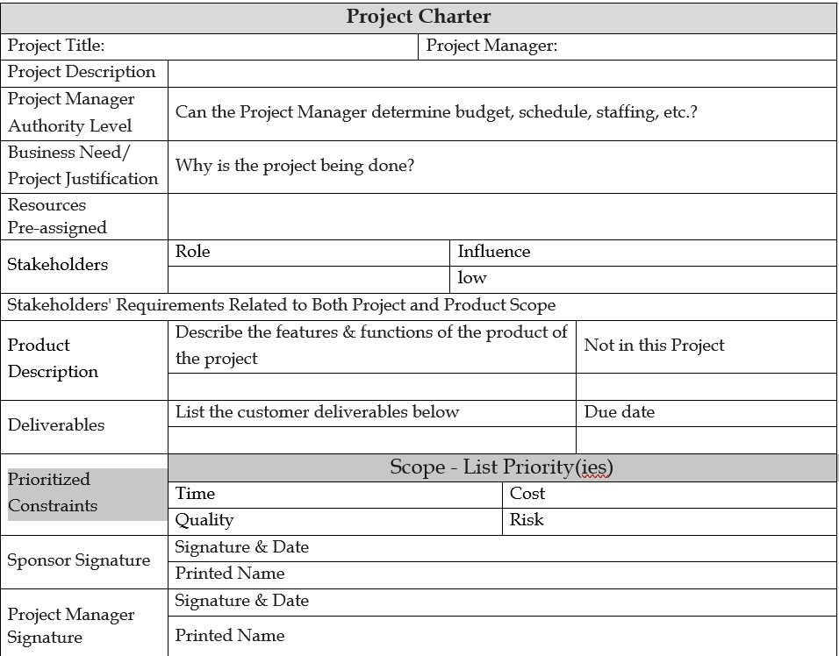

Slide 20
Develop Project Charter
Output: Assumption Log
High-level strategic and operational assumptions and constraints are normally identified in the business case before the project is initiated and will flow into the project charter
Assumption ID | Assumption Description | Assumption Owner | Date Identified | Status | Mitigation/Contingency Plan
A002 | The project team will have uninterrupted access to the required software development environment. | IT Team | 01/15/2024 | Closed | Confirmed with IT that the development environment is set up and will be maintained.
A003 | Stakeholders will provide timely feedback on project deliverables. | Project Manager | 01/16/2024 | Open | Schedule regular stakeholder meetings; Send timely reminders for feedback.
The assumption log is used to record all assumptions and constraints throughout the project life cycle

Slide 21
Prepare your own Project Charter
IUT is planning to organize an App development contest on last Friday of December. As a 4th year student, you are selected as a project manager for this big event. Prepare a project plan.

Slide 22
Identify Stakeholders
The process of identifying all people or organizations impacted by the project, and documenting relevant information regarding their interests, involvement, and impact on project success
Process
Output
Identify Stakeholders
Stakeholder Register

Slide 23
Identify Stakeholders
Input
Project charter
Tools & Techniques
Expert judgment
Output
Stakeholder register
Business documents
Project management plan
Project documents
Agreements
EEF
OPA
Data gathering
Data analysis
Data representation
Change requests
Project management plan updates
Project documents updates
Meetings

Slide 24
Identify Stakeholders
Input:
PROJECT CHARTER
  identifies the key stakeholder list.
  contain information about the responsibilities of the stakeholders
BUSINESS DOCUMENTS
  Business case - identifies an initial list of stakeholders affected by the project.
  Benefits management plan - may identify the individuals and groups that will benefit from the delivery of the outcomes of the project
PROJECT MANAGEMENT PLAN
  Communications management plan - is a source of knowledge about the project’s stakeholders.
  Stakeholder engagement plan - identifies the management strategies and actions required to effectively engage stakeholders
PROJECT DOCUMENTS
  Change log - may introduce a new stakeholder or change the nature of an existing stakeholder’s relationship to the project.
  Issue log -
  Requirements documentation - can provide information on potential stakeholders
AGREEMENTS
  can contain references to additional stakeholders

Slide 25
Identify Stakeholders
Input: Enterprise Environmental Factor
EEF
Organizational culture and political climate,
Geographic distribution of facilities
Global, local trends and practices or habits
industry standards

Slide 26
Identify Stakeholders
Input: Organizational process assets
OPA
Stakeholder register templates and instructions
Stakeholder registers from previous projects
Lessons learned repository

Slide 27
Identify Stakeholders
Tools & Techniques:
Expert Judgement
  Understanding the politics and power structures in the organization,
  Knowledge of the environment and culture of the organization and other affected organizations including customers and the wider environment,
  Knowledge of the industry or type of project deliverable, and
  Knowledge of individual team member contributions and expertise
Date Gathering
  Questionnaires and surveys
  Brainstorming
Date Analysis
  Stakeholder Analysis: Interest, right, ownership, knowledge, contribution
  Document Analysis: Assessing the available project documentation and lessons
  learned from previous projects to identify stakeholders and other supporting information

Slide 28
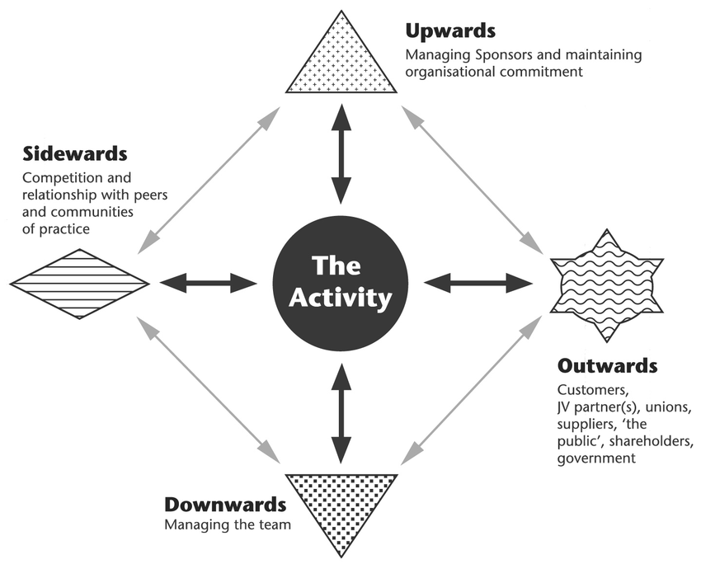
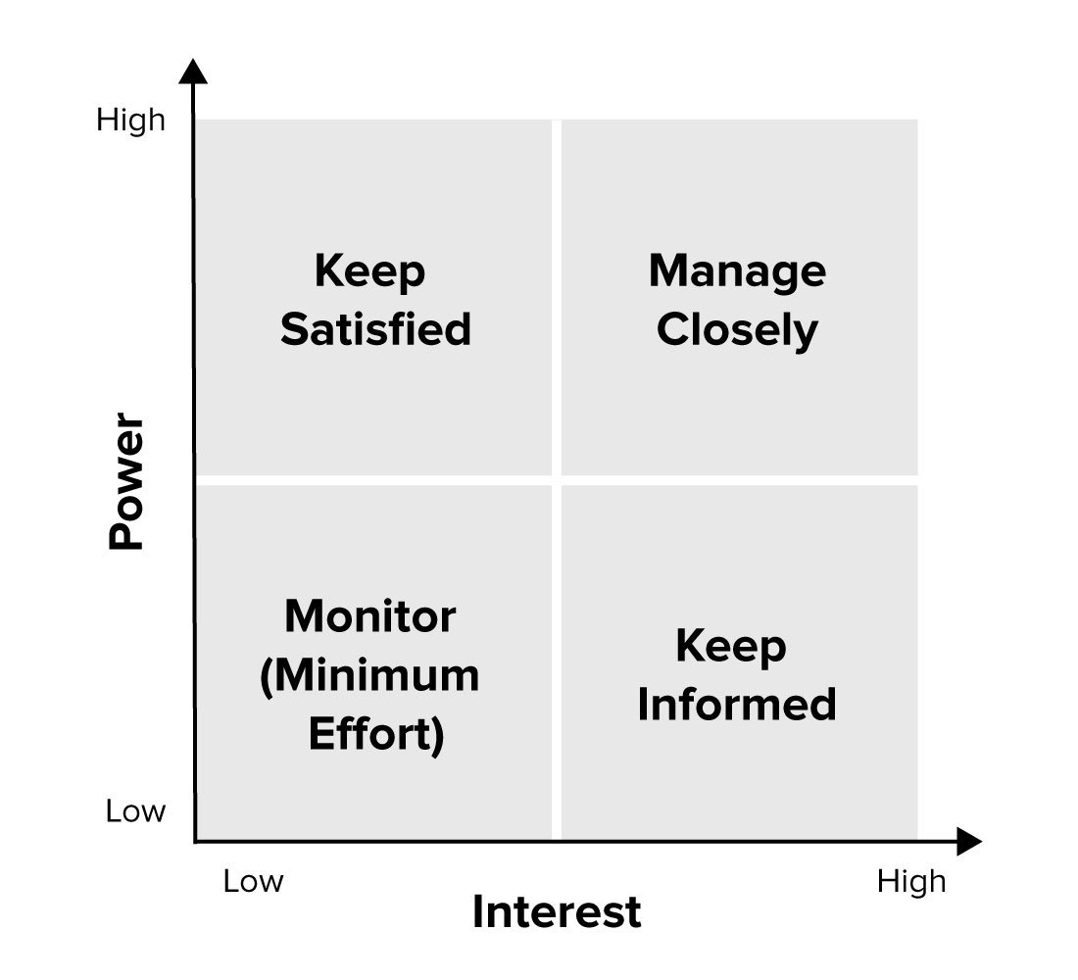
Identify Stakeholders
Directions of influence
Tools & Techniques:
Data Representation
Power/Interest Grid for Stakeholder Prioritization
Meetings
  Identify Project Stakeholders

Slide 29
Identify Stakeholders
Output:
Stakeholder register
  Identification: name, position, role in project
  Assessment: major requirement, main expectation
  Classification: internal/ external
ID | Name | Type | Role | Contact | Influence level | Communication Channel | Frequency of Communication
Change Request
Project Management Plan update
  Requirement Management Plan, Communication Management Plan, Risk Management Plan, Stakeholder engagement plan
Project Documents update
  Assumption log, Issue Log, Risk register

Slide 30
Prepare Stakeholder Register
Prepare stakeholder register for the App development contest

Slide 31
End of Initiating Process Group

